Slide 1
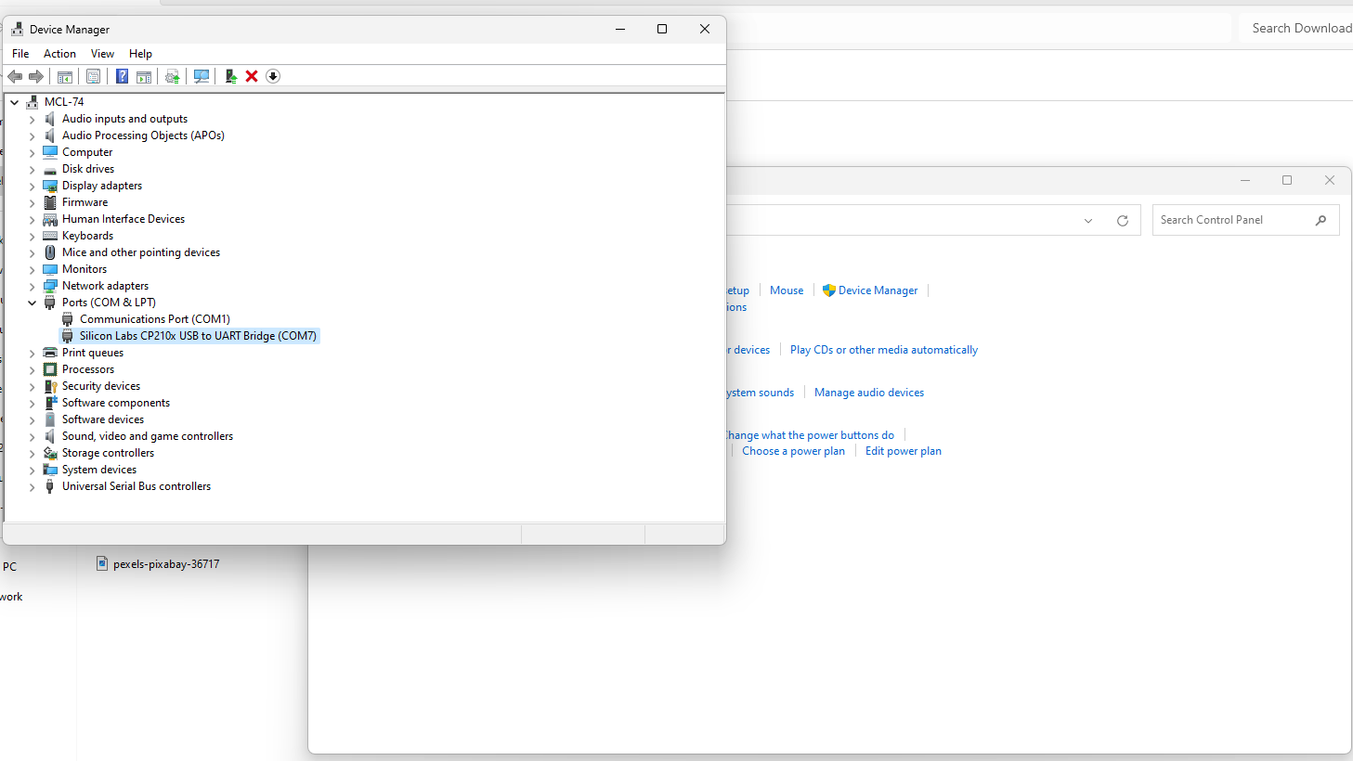
NodeMCU - Installing ESP32 Board in the Arduino IDE
Step 1: Installing or Updating the Arduino IDE
Step 2: Installing the USB-to-Serial Bridge Driver
https://www.silabs.com/products/development-tools/software/usb-to-uart-bridge-vcp-drivers
http://www.wch-ic.com/downloads/CH341SER_ZIP.html
https://raw.githubusercontent.com/espressif/arduino-esp32/gh-pages/package_esp32_index.json

Slide 2
Use CaseStudy Environmental monitoring using NodeMCU (ESP32) with DHT22 and Thingspeak Cloud Computing

Slide 3
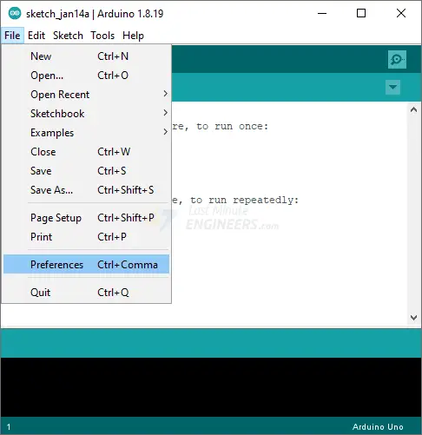
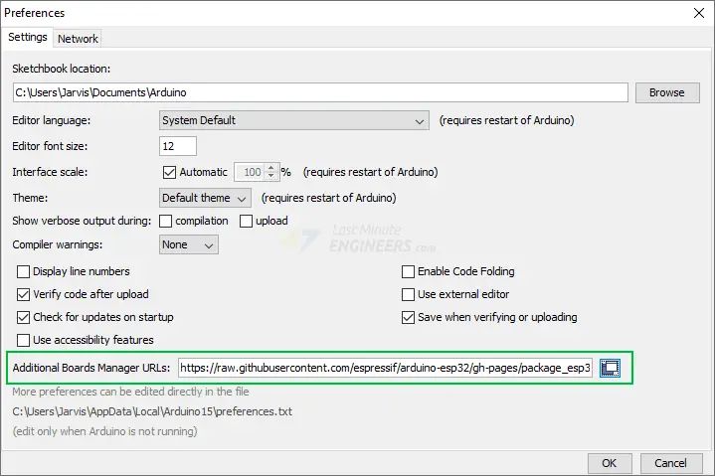
NodeMCU - Installing ESP32 Board in the Arduino IDE
Step 1: Installing or Updating the Arduino IDE
Step 2: Installing the USB-to-Serial Bridge Driver
https://www.silabs.com/products/development-tools/software/usb-to-uart-bridge-vcp-drivers
http://www.wch-ic.com/downloads/CH341SER_ZIP.html
Step 3: Installing the ESP32 Arduino Core
https://raw.githubusercontent.com/espressif/arduino-esp32/gh-pages/package_esp32_index.json

Slide 4
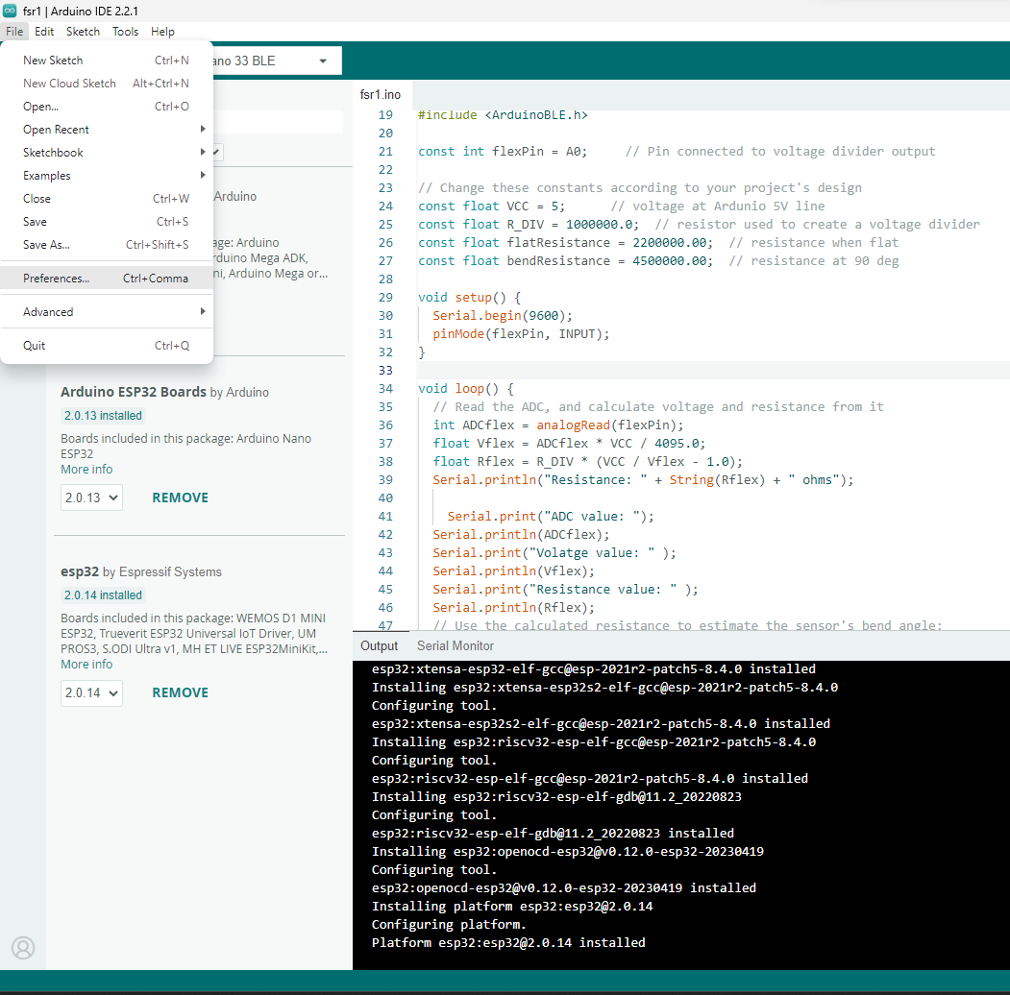
NodeMCU - Installing ESP32 Board in the Arduino IDE
Step 3: Installing the ESP32 Arduino Core
https://raw.githubusercontent.com/espressif/arduino-esp32/gh-pages/package_esp32_index.json

Slide 5
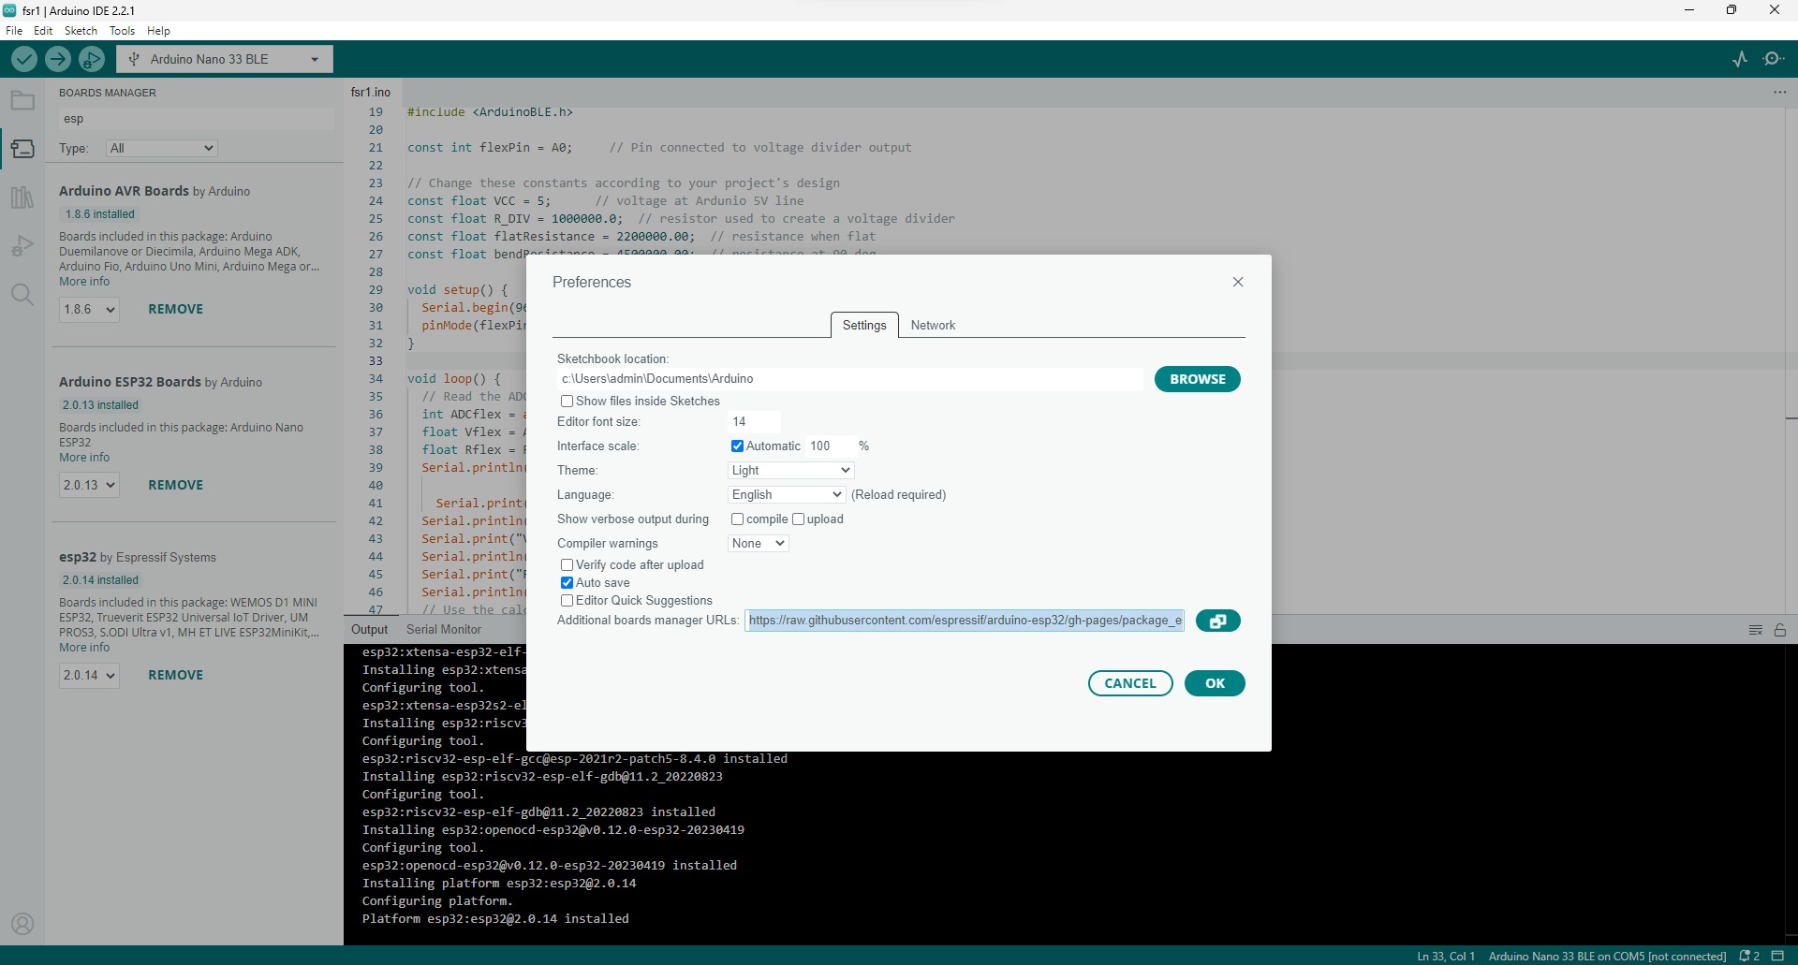
NodeMCU - Installing ESP32 Board in the Arduino IDE
Step 3: Installing the ESP32 Arduino Core
https://raw.githubusercontent.com/espressif/arduino-esp32/gh-pages/package_esp32_index.json

Slide 6
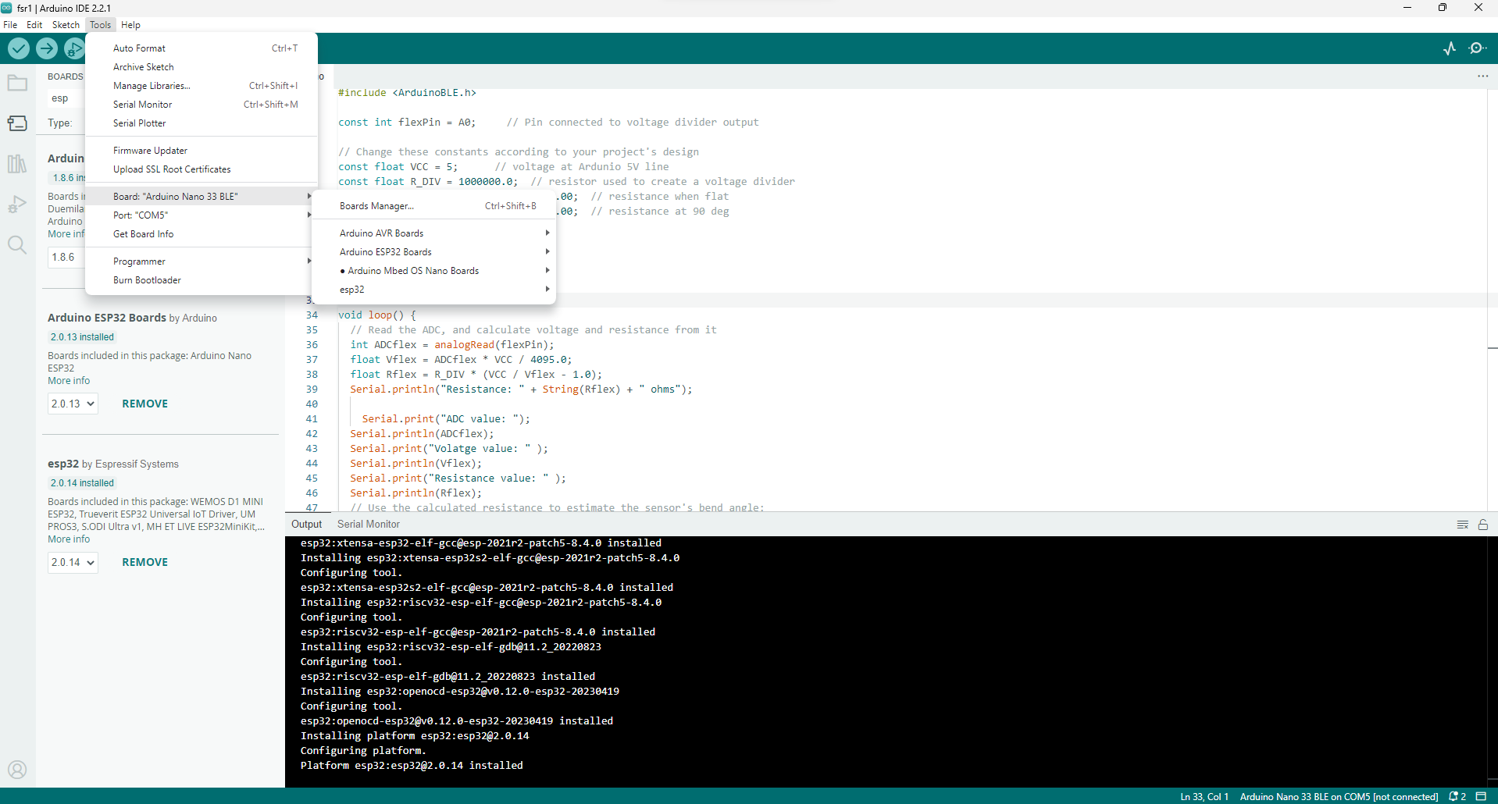
NodeMCU - Installing ESP32 Board in the Arduino IDE
Step 3: Installing the ESP32 Arduino Core
Environmental monitoring using NodeMCU (ESP32) with DHT22
Environmental monitoring using NodeMCU (ESP32) with DHT22

Slide 7
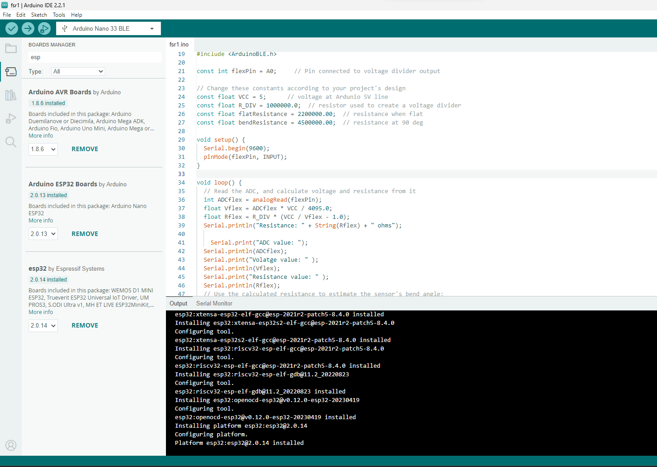
NodeMCU - Installing ESP32 Board in the Arduino IDE
Step 3: Installing the ESP32 Arduino Core
a. Install Arduino ESP32
b. ESP32

Slide 8
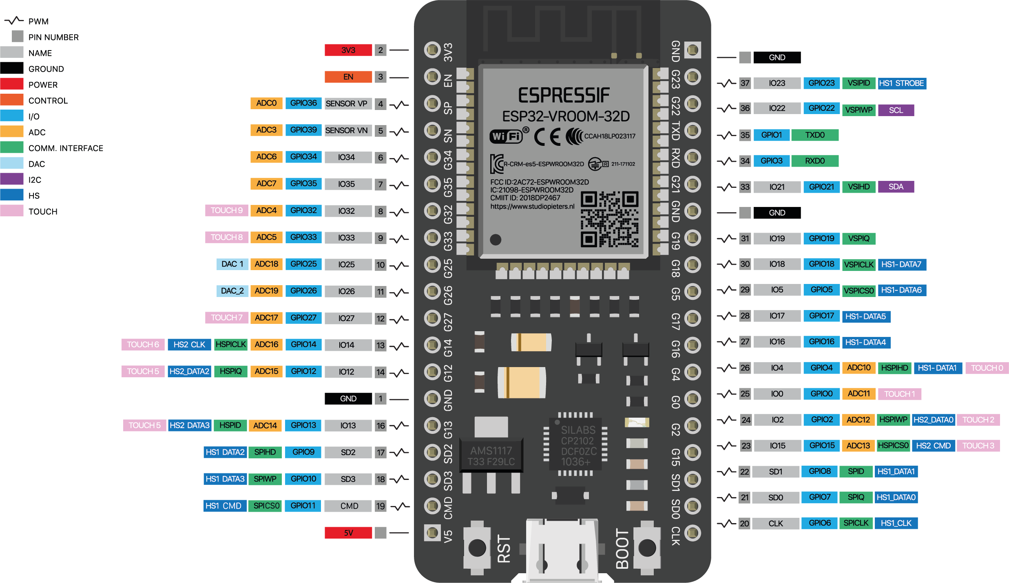
NodeMCU
Courtesy:
https://www.studiopieters.nl/esp32-pinout/

Slide 9
NodeMCU
ESP32 Peripherals and I/O
48 GPIO pins in total, only 25 of them are broken out to the pin headers on both sides of the development board. These pins can be assigned a variety of peripheral duties, including:
15 ADC channels | 15 channels of 12-bit SAR ADC with selectable ranges of 0-1V, 0-1.4V, 0-2V, or 0-4V
2 UART interfaces | 2 UART interfaces with flow control and IrDA support
25 PWM outputs | 25 PWM pins to control things like motor speed or LED brightness
2 DAC channels | Two 8-bit DACs to generate true analog voltages
SPI, I2C and I2S interface | Three SPI and one I2C interfaces for connecting various sensors and peripherals, as well as two I2S interfaces for adding sound to your project
9 Touch Pads | 9 GPIOs with capacitive touch sensing
Courtesy:
https://www.studiopieters.nl/esp32-pinout/

Slide 10
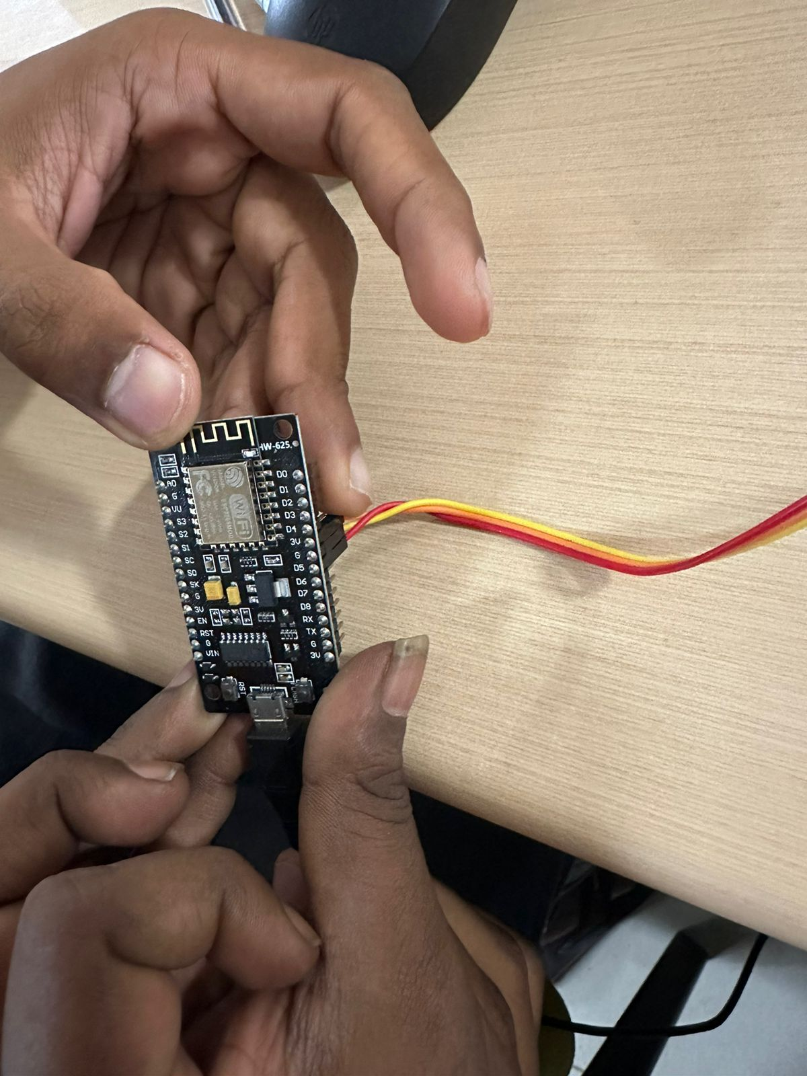
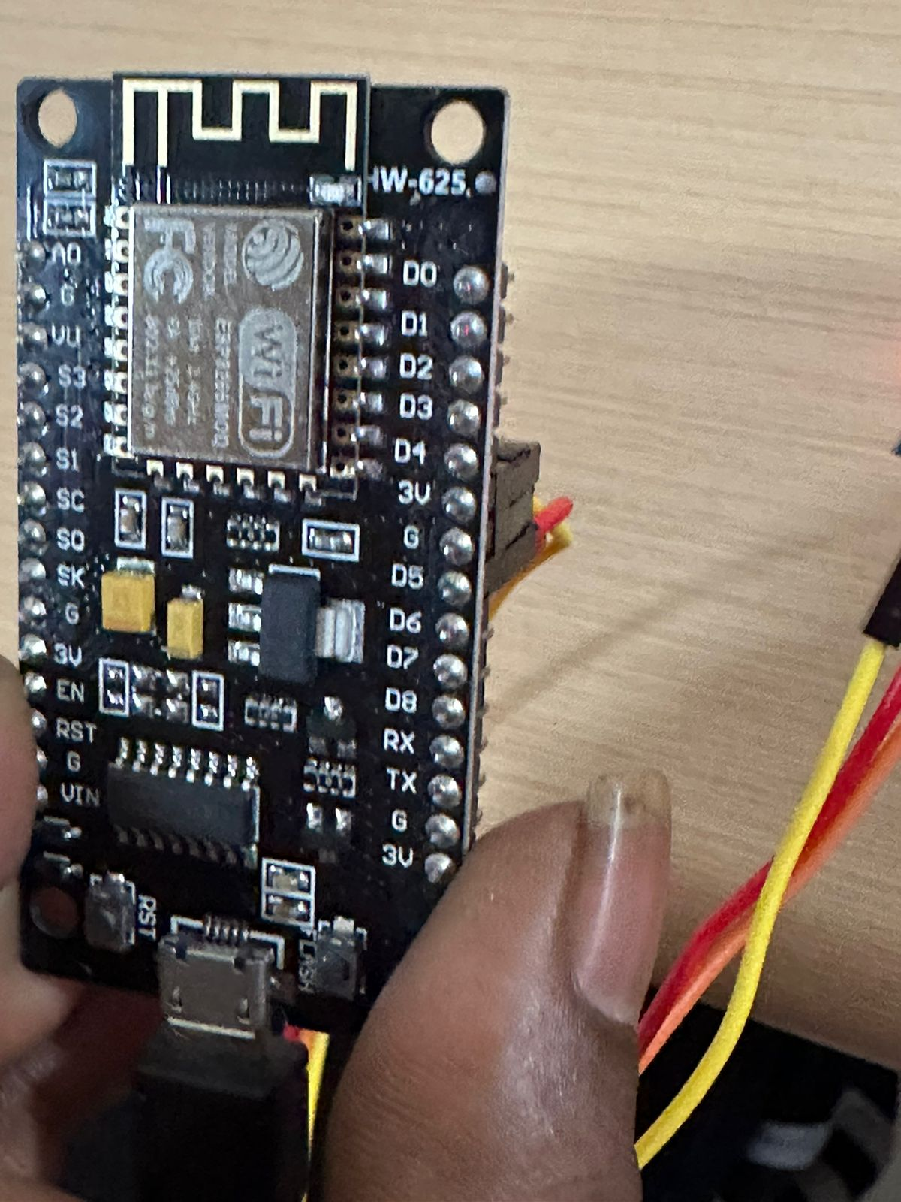
NodeMCU – DHT 11 interfacing
Courtesy: Lab@602 AB3

Slide 11
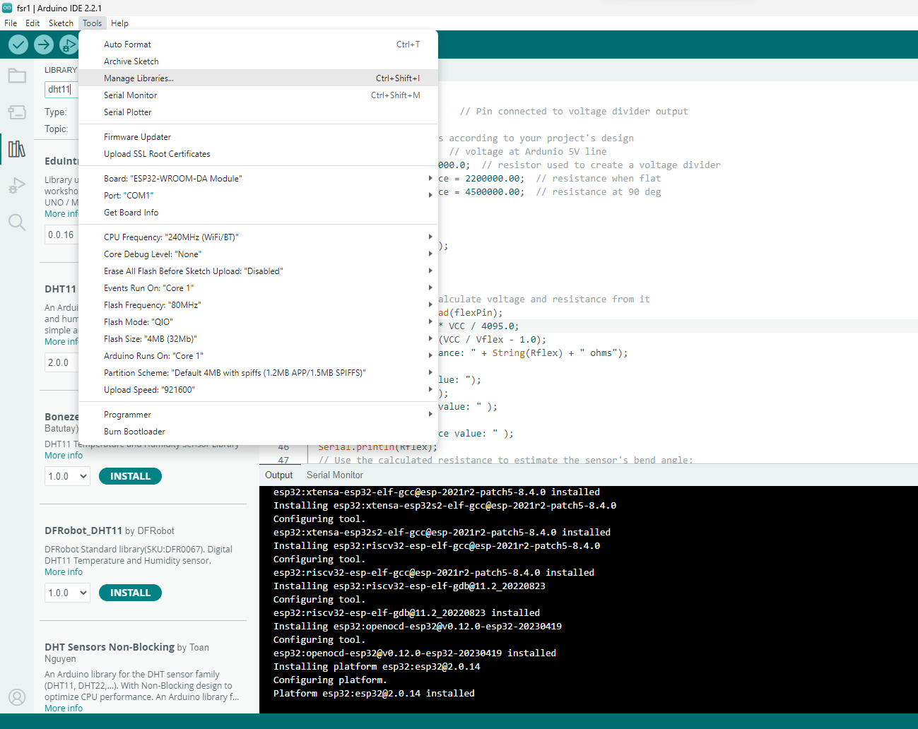
NodeMCU

Slide 12
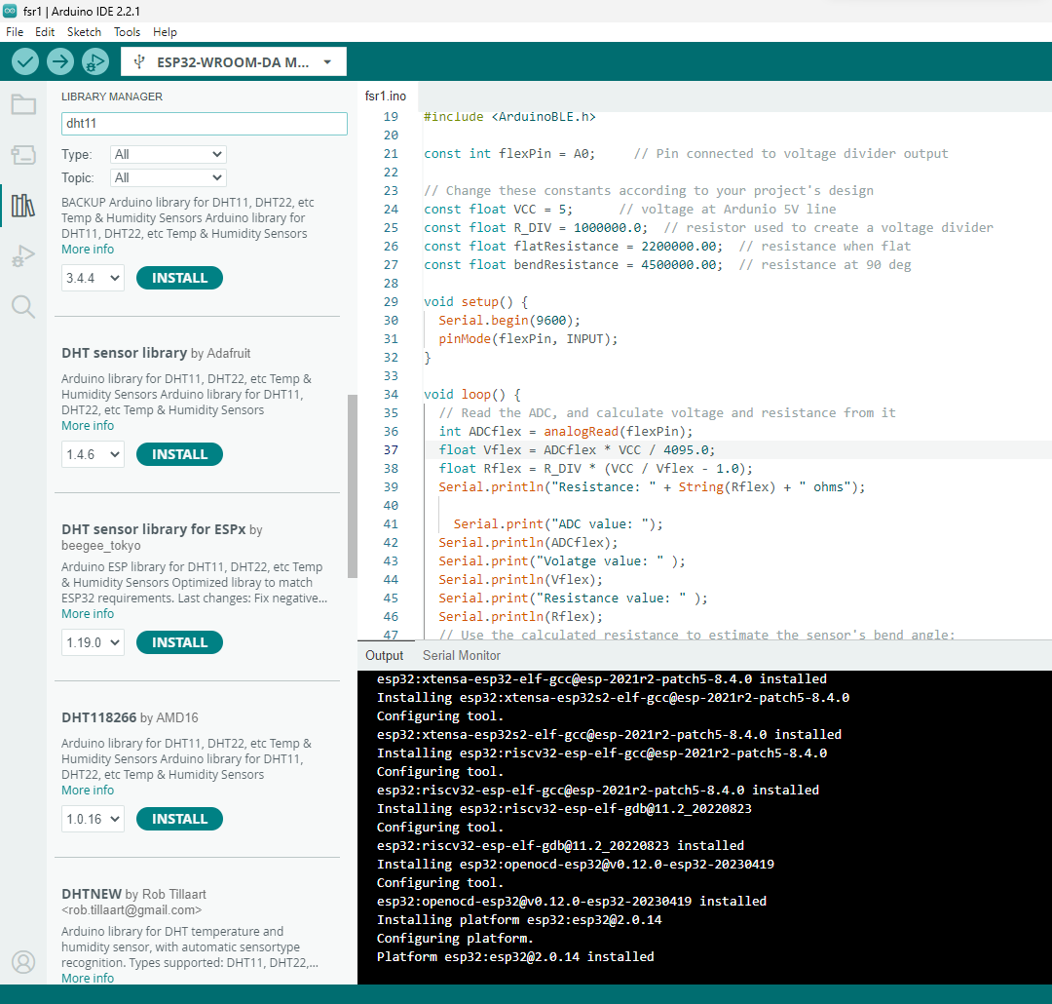
NodeMCU

Slide 13
NodeMCU (Environmental Program)
#include <ESP8266WiFi.h>
#include <DHT.h>
#include <ThingSpeak.h>
DHT dht(D5, DHT11);
WiFiClient client;
const char *ssid = "Rahul";
const char *pass = "12345678";
long myChannelNumber = 2400352;
const char myWriteAPIKey[] = "DT6UNP5Q36ARTV4U";
Wifi connection Since Simulation
No need for representing the
Wifi Name as well as WIFI Password
ThingSpeak Configuration www.thingspeak.com
APIKey:
Need to be represented in programming as well as the Thingspeak for sending the data from hardware to the cloud server thingspeak

Slide 14
NodeMCU (Environmental Program)
void setup() {
// put your setup code here, to run once:
Serial.begin(115200);
WiFi.begin(ssid, pass);
while(WiFi.status() != WL_CONNECTED)
{
delay(200);
Serial.print("..");
}
Serial.println();
Serial.println("NodeMCU is connected!");
Serial.println(WiFi.localIP());
dht.begin();
ThingSpeak.begin(client);
}
DHT11 Library (as discussed in previous experiment

Slide 15
NodeMCU (Environmental Program)
void loop() {
// put your main code here, to run repeatedly:
float h = dht.readHumidity();
float t = dht.readTemperature();
Serial.println("Temperature: " + (String) t);
Serial.println("Humidity: " + (String) h);
ThingSpeak.writeField(myChannelNumber, 1, t, myWriteAPIKey);
ThingSpeak.writeField(myChannelNumber, 2, h, myWriteAPIKey);
delay(10);
}
Applicable only for real time implmentation
Thingspeak Library
Arduino IDE -> Tools -> Manage Libraries -> Type Thingspeak and install the library

Slide 16
NodeMCU (Environmental Program)
Parameters:
Humidity
Temperature
Are the both fields or variables to transfer the data from the hardware to the Thingspeak cloud for data visualization

Slide 17
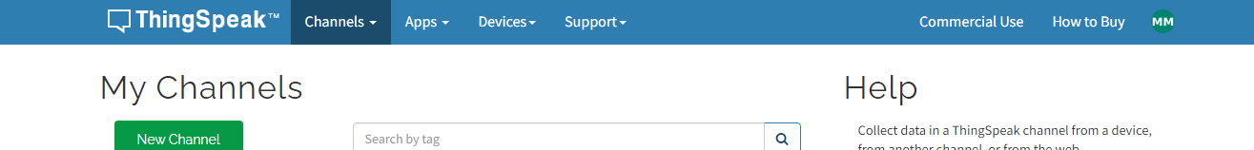
ThingSpeak Configuration for ESP32

Slide 18
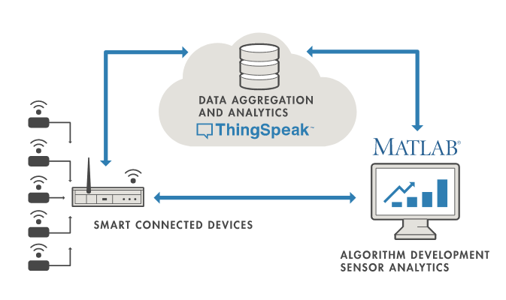
ThingSpeak

Slide 19
ThingSpeak Configuration for ESP32
Channel Settings
Percentage complete: Calculated based on data entered into the various fields of a channel. Enter the name, description, location, URL, video, and tags to complete your channel.
Channel Name: Enter a unique name for the ThingSpeak channel.
Description: Enter a description of the ThingSpeak channel.
Field#: Check the box to enable the field, and enter a field name. Each ThingSpeak channel can have up to 8 fields.
Metadata: Enter information about channel data, including JSON, XML, or CSV data.
Tags: Enter keywords that identify the channel. Separate tags with commas.
Link to External Site: If you have a website that contains information about your ThingSpeak channel, specify the URL.
Show Channel Location:
Latitude: Specify the latitude position in decimal degrees. For example, the latitude of the city of London is 51.5072.
Longitude: Specify the longitude position in decimal degrees. For example, the longitude of the city of London is -0.1275.
Elevation: Specify the elevation position meters. For example, the elevation of the city of London is 35.052.
Video URL: If you have a YouTube™ or Vimeo® video that displays your channel information, specify the full path of the video URL.
Link to GitHub: If you store your ThingSpeak code on GitHub®, specify the GitHub repository URL.
Using the Channel
You can get data into a channel from a device, website, or another ThingsSpeak channel. You can then visualize data and transform it using ThingSpeak Apps.
See Get Started with ThingSpeak" for an example of measuring dew point from a weather station that acquires data from an Arduino® device.

Slide 20
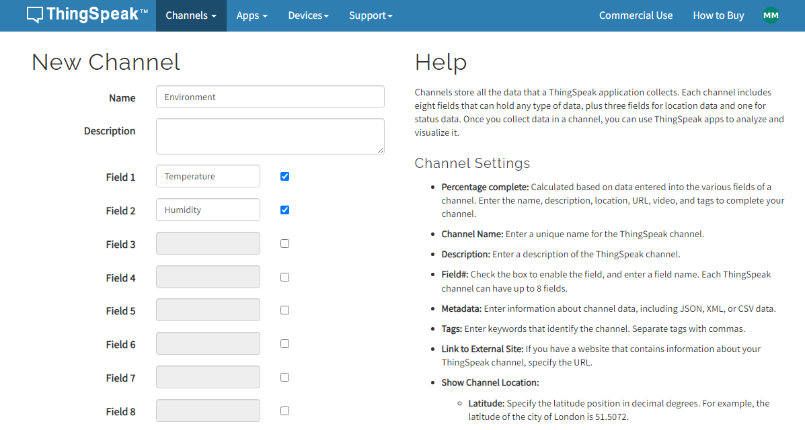
ThingSpeak Configuration for ESP32

Slide 21
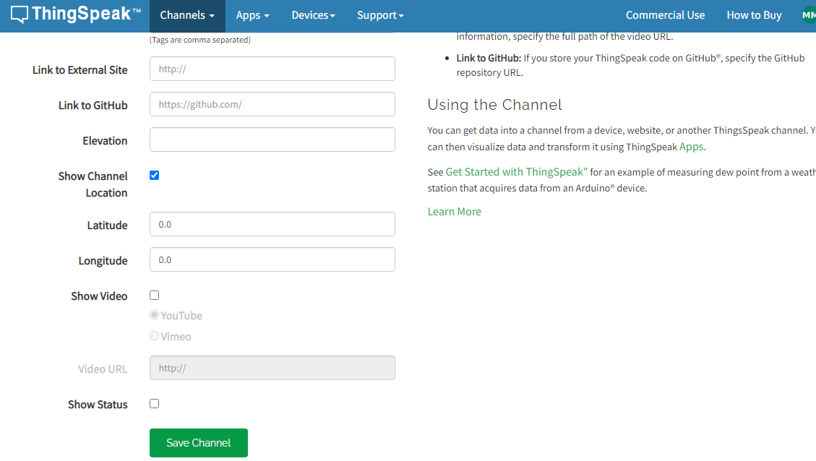
ThingSpeak Configuration for ESP32

Slide 22
ThingSpeak Configuration for ESP32
Save the Channel

Slide 23
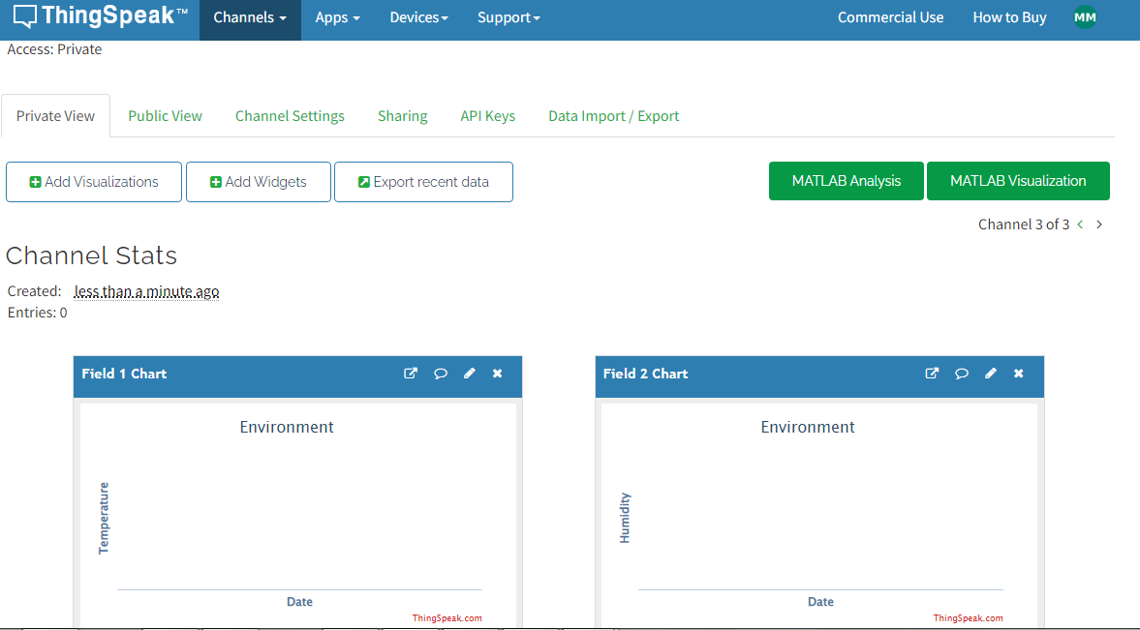
ThingSpeak Configuration for ESP32
Reconfiguring Channel
Note down the Write API Key
Different Visualization

Slide 24
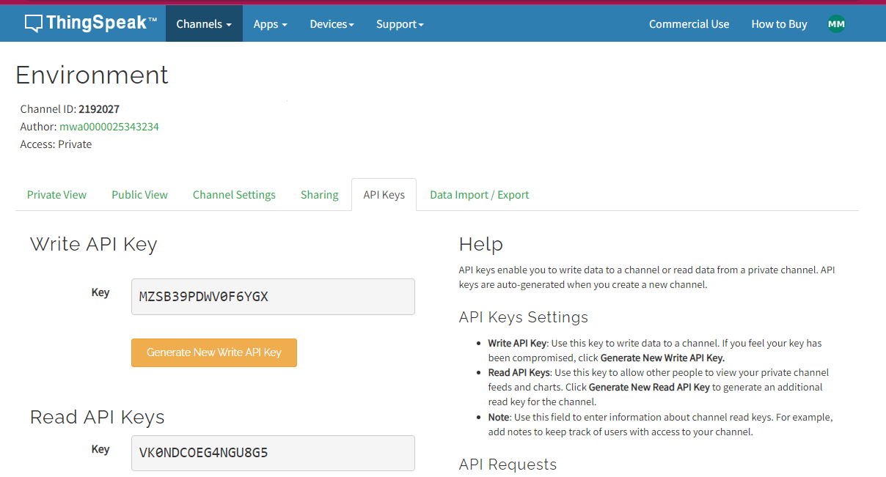
ThingSpeak Configuration for ESP32
Write API Key – Data transfer from Hardware to Thingspeak

